Slide 1
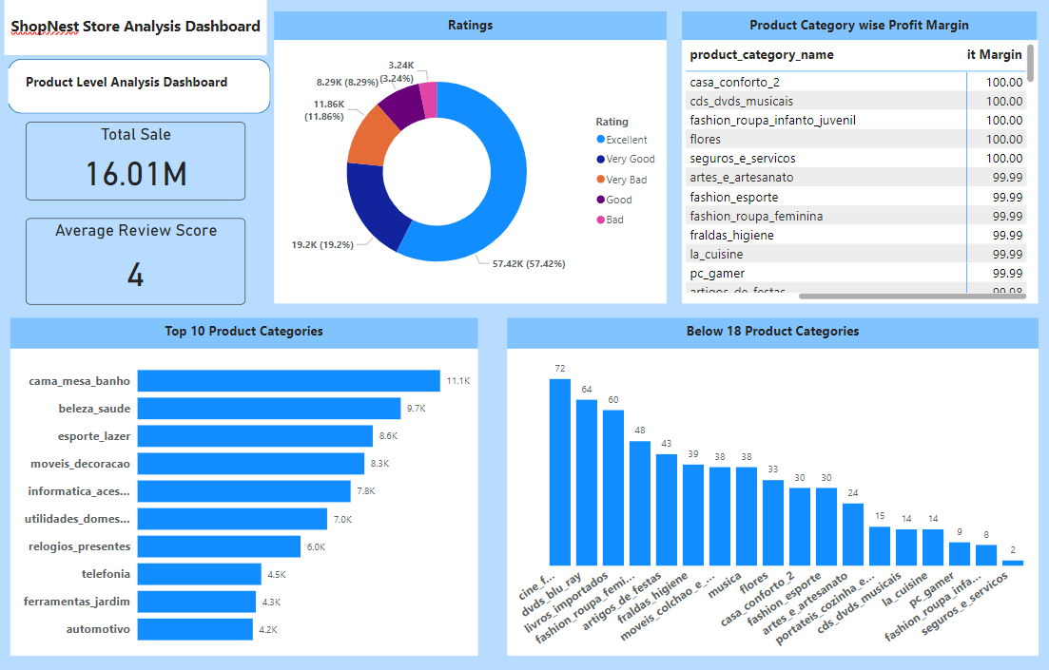
Product Level Analysis Dashboard

Slide 2
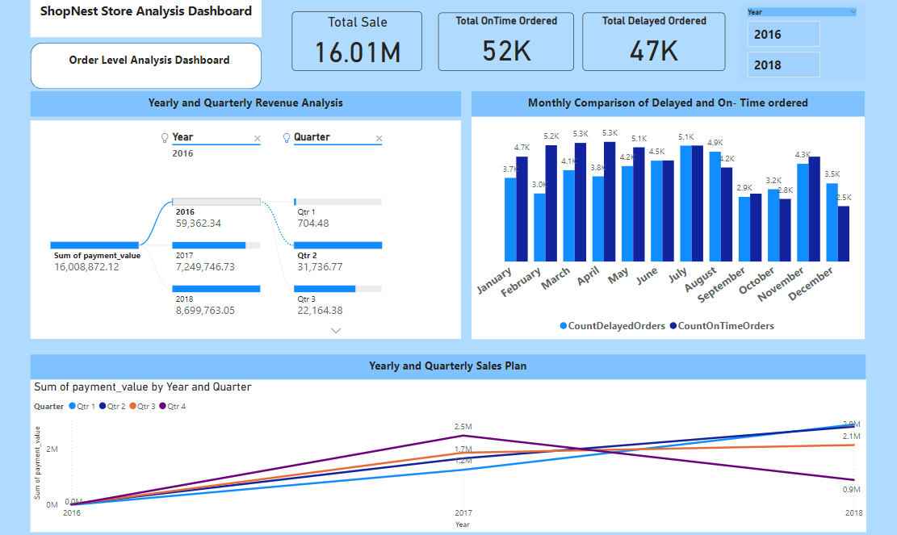
Order Level analysis Dashboard

Slide 3
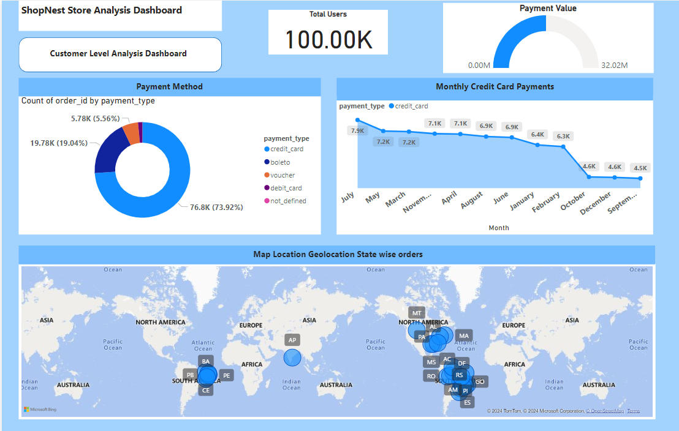
Customer Level Analysis Dashboard

